Slide 1

Sunday 27th – Wednesday 30th June 2027
Accompanied by Miss Abbott and other school staff known to the children.

Slide 2


Slide 3
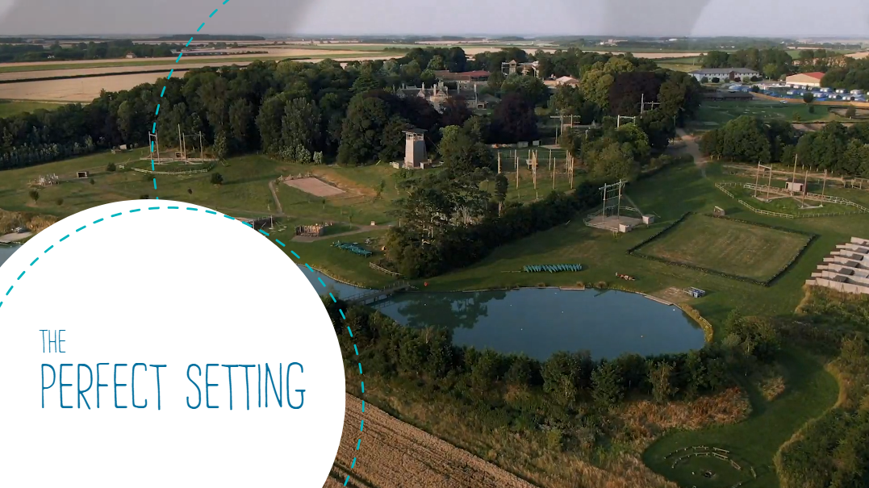
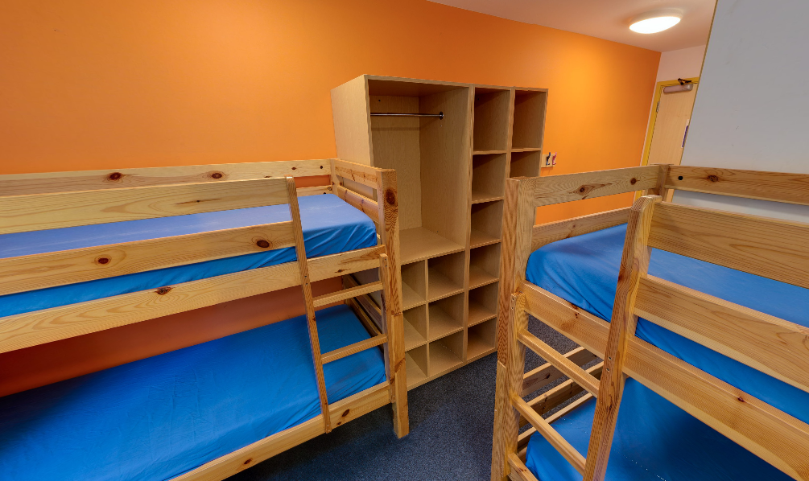
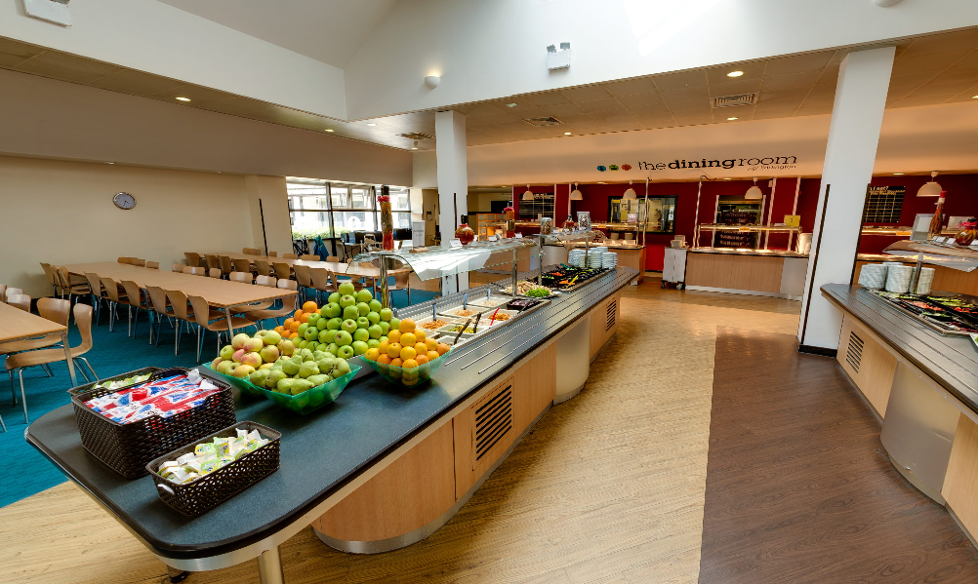
Purpose-built, modern accommodation.
An incredible range of activities, including watersport adventures at one of three on-site lakes.
Qualified, outdoor education experts.

Slide 4
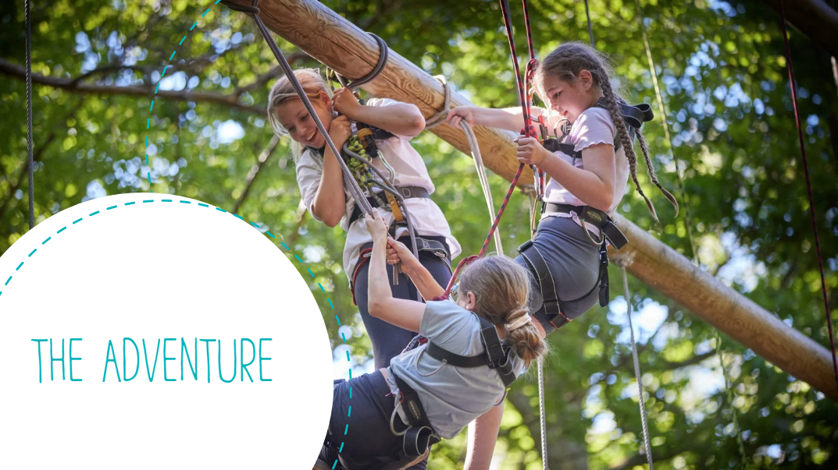

Slide 5


Slide 6
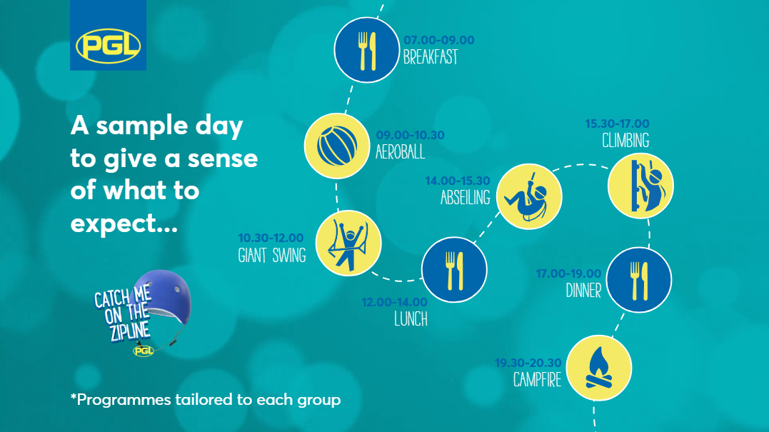

Slide 7
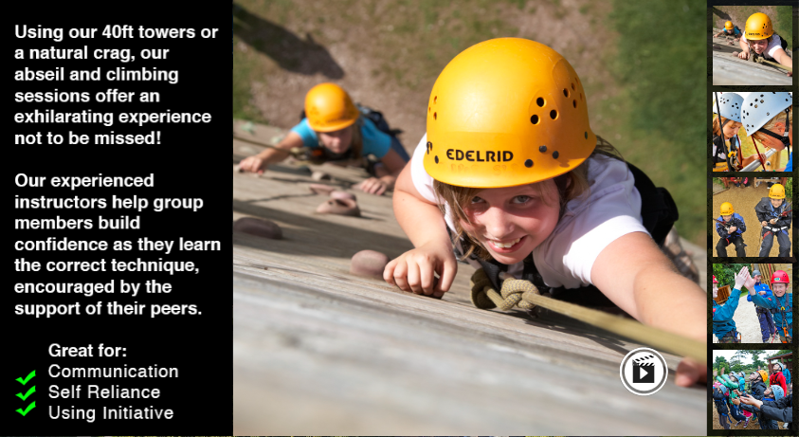
Possible activity: climbing/abseiling

Slide 8
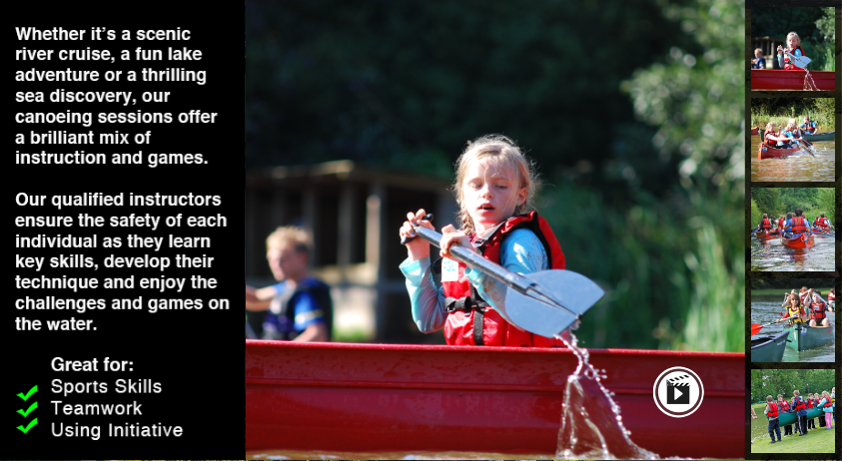
Possible activity: canoeing

Slide 9
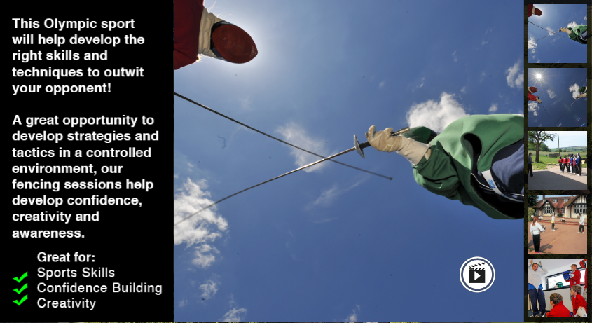
Possible activity: fencing

Slide 10
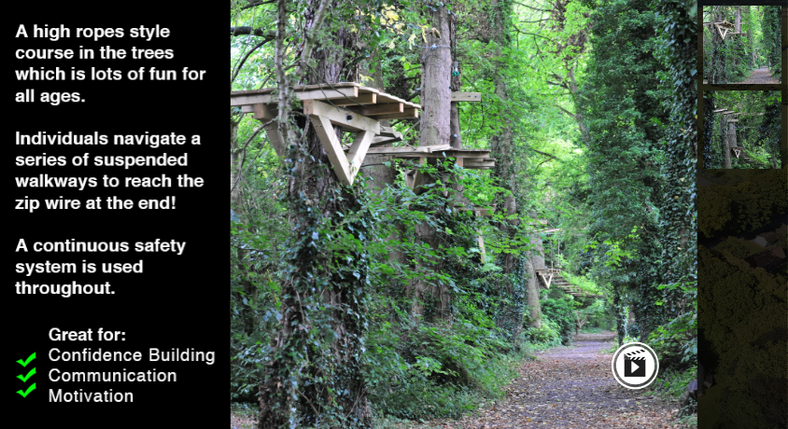
Possible activity: treetop trail

Slide 11
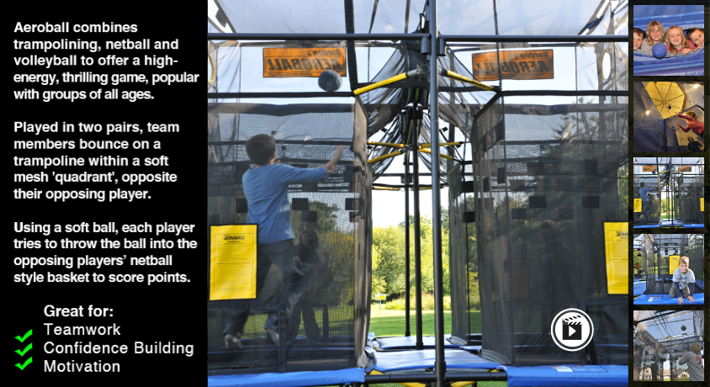
Possible activity: aeroball

Slide 12
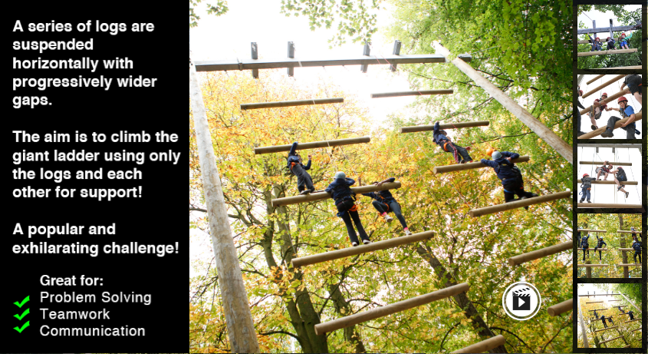
Possible activity: Jacob’s ladder

Slide 13
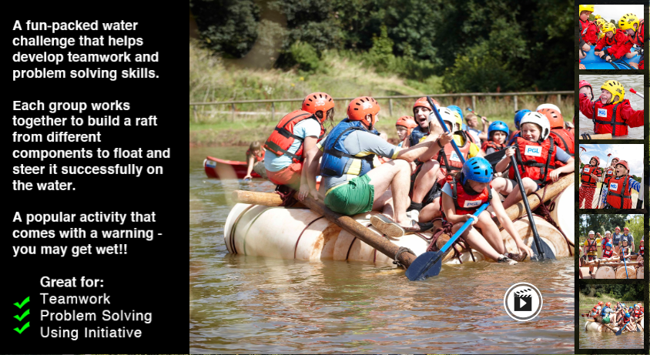
Possible activity: raft building

Slide 14
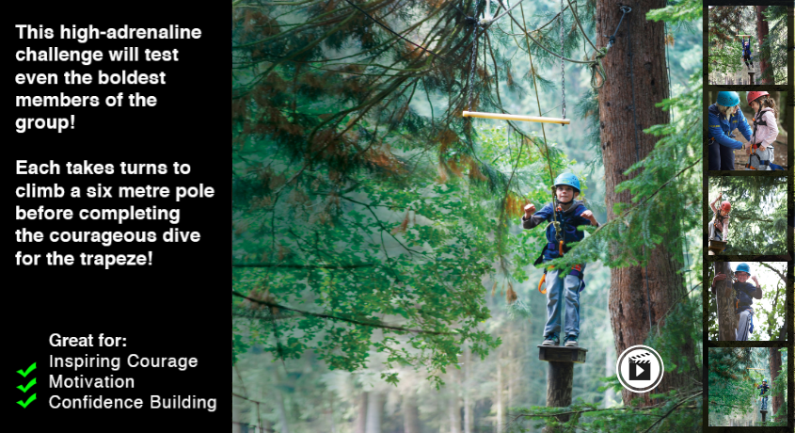
Possible activity: trapeze

Slide 15
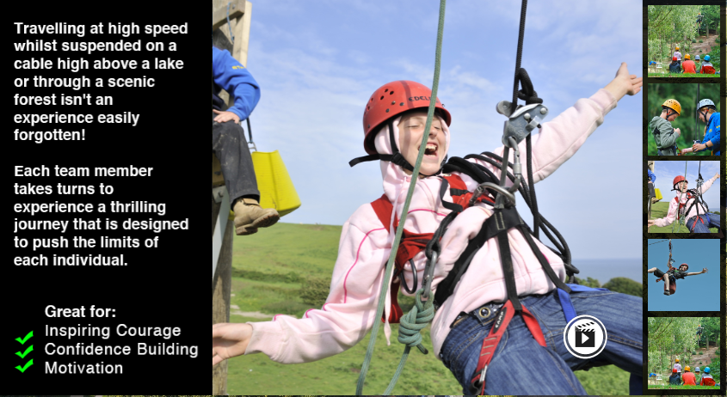
Possible activity: zip wire

Slide 16
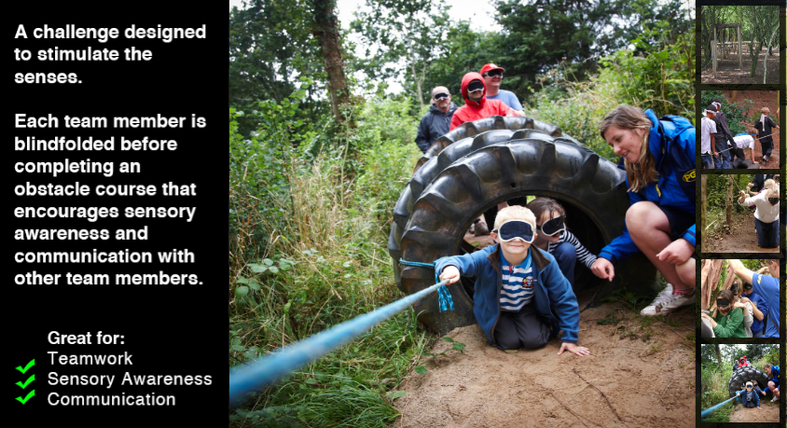
Possible activity: sensory trail

Slide 17


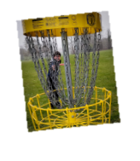
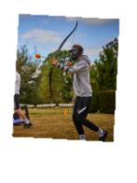
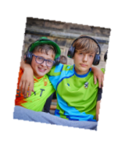
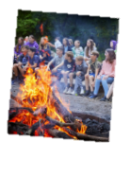


Slide 18
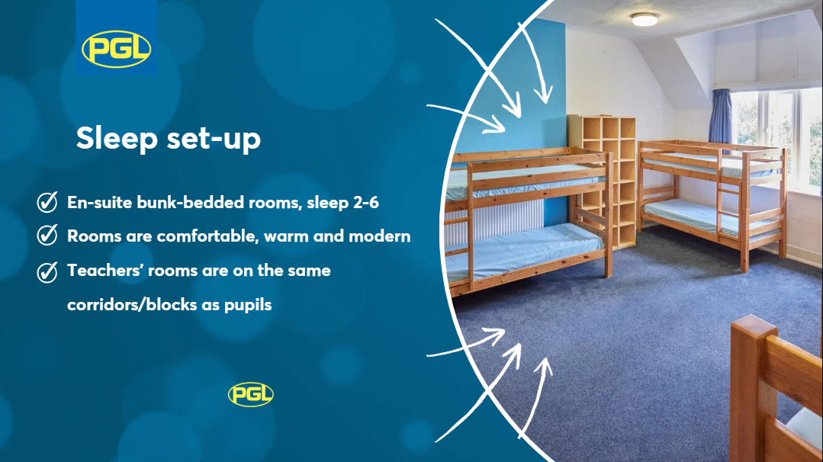

Slide 19


Slide 20



Slide 21


Slide 22


