Slide 1
Get a Head Start on…
Year 5
Helping Your Child Feel Confident and Ready for the Year Ahead!

Slide 2

Why Prepare Over Summer?
Prevent the 'summer slide'
Build confidence before Year 5
Form positive habits in a relaxed environment
Nothing too intense – just a few simple activities can make such a difference

Slide 3
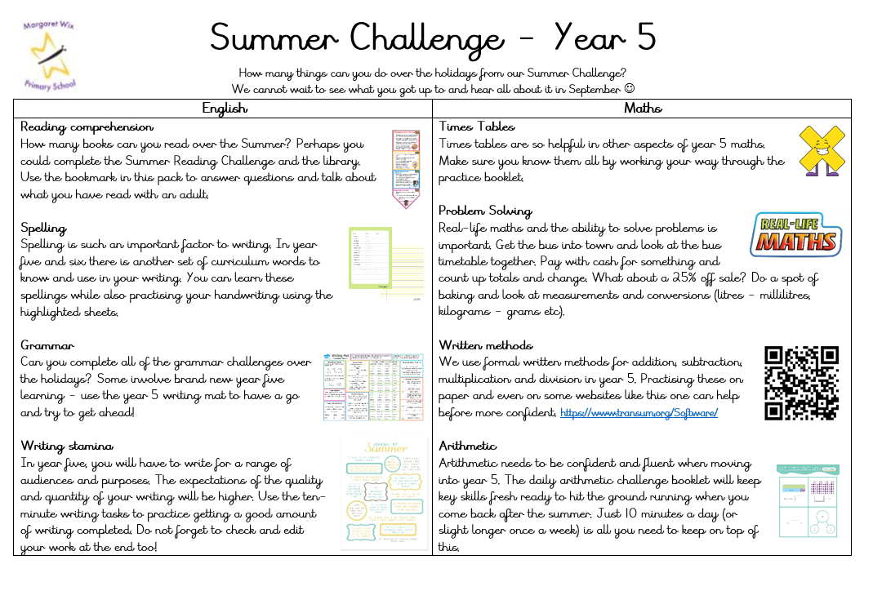
Focus Areas – Year 5 Core Subjects
English:
Reading comprehension
Spelling
Grammar
Writing stamina
Maths:
Times tables
Problem solving
Written methods
Arithmetic

Slide 4



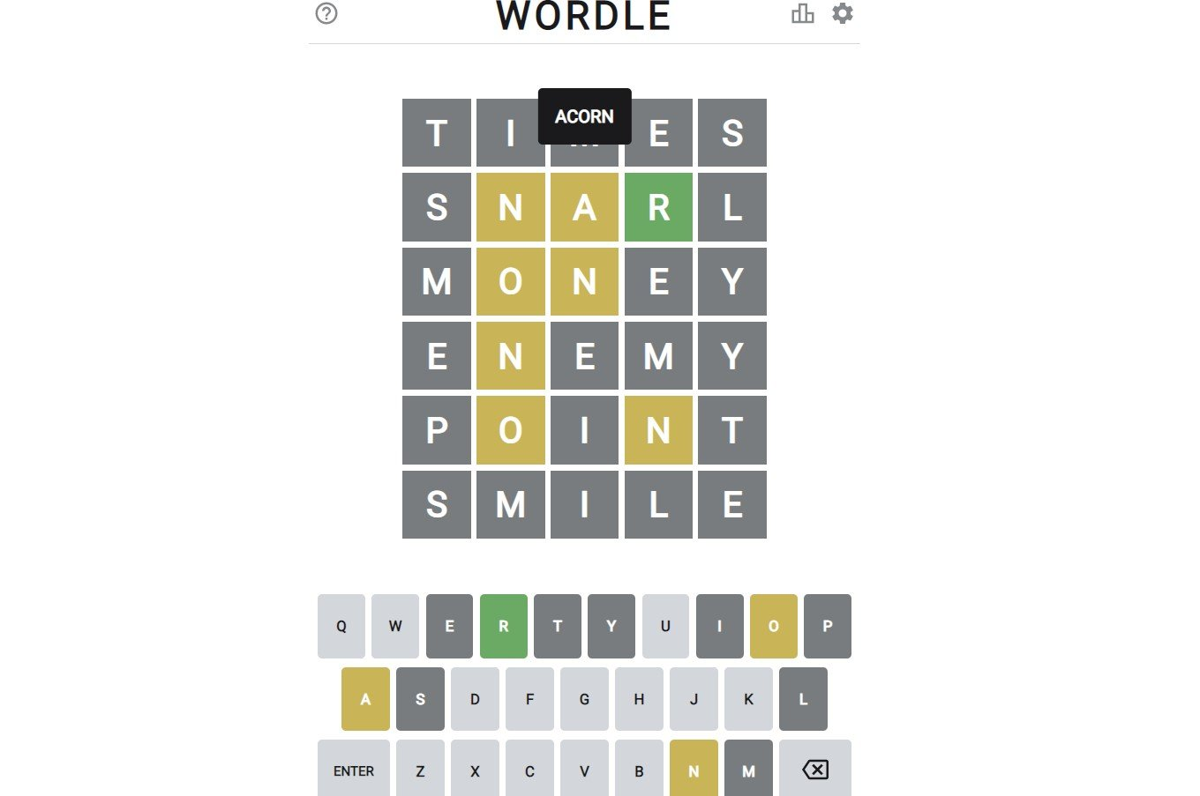
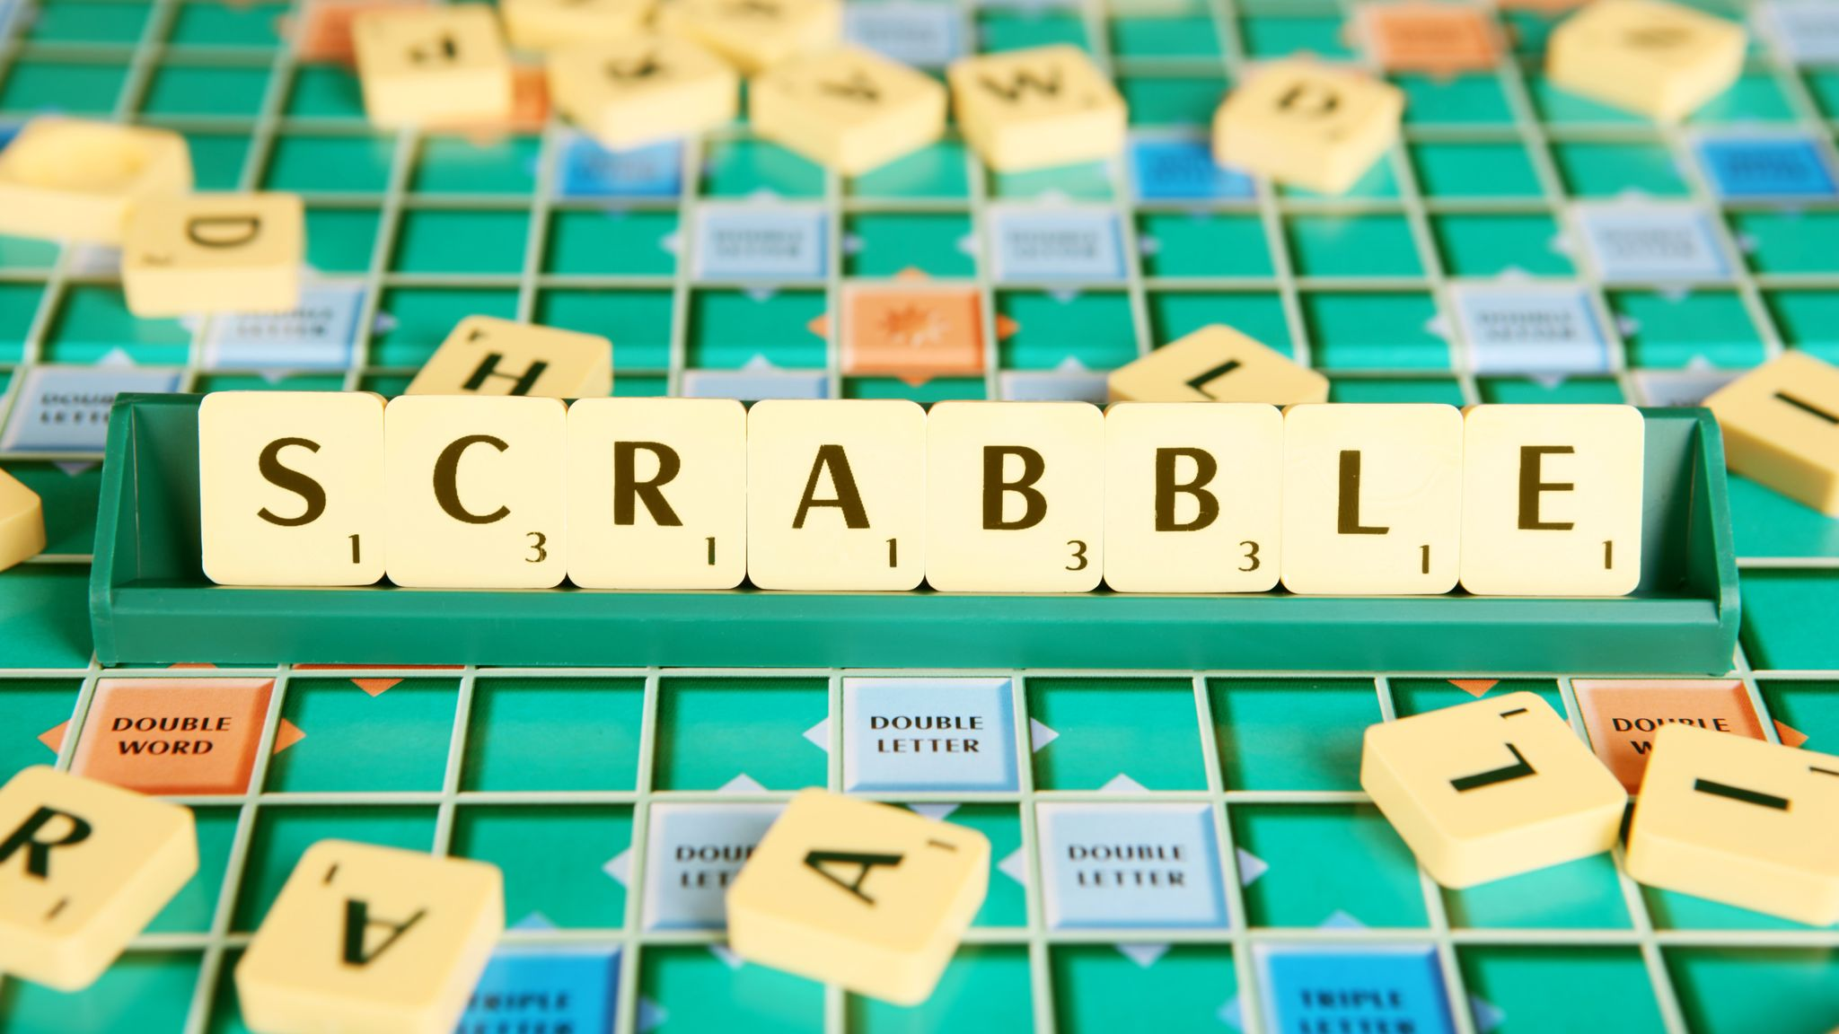
English – Practical Ideas for Home
📚 Reading Together:
Daily reading (20 min)
Mix fiction & non-fiction
Ask questions about the text
📝 Writing Practice:
Summer journal
Postcards or letters
Create stories or comics
🎲 Grammar Fun:
Word games
'Word of the day'
Spot punctuation

Slide 5


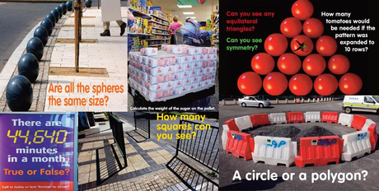

Maths – Practical Ideas for Home
🔢 Times Tables:
Use apps (e.g. TTRockstars)
Practise casually
 Problem Solving:
Use real-life maths
Puzzle books & games
💡 Focus Topics:
Fractions, decimals
Shopping with percentages
5–10 quick questions daily

Slide 6

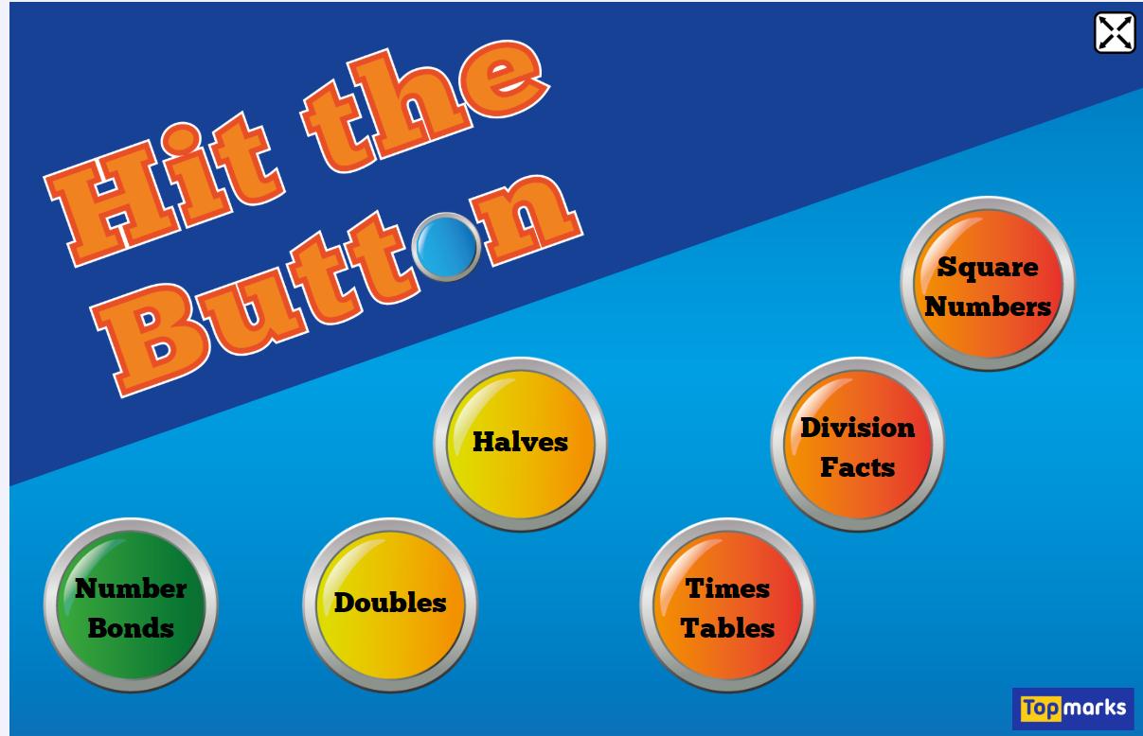
Screen Time Can Be Learning Time
Educational YouTube (e.g. BBC Bitesize)
Audiobooks for car journeys or quiet time
Maths and grammar games
  https://www.bbc.co.uk/bitesize/primary
  https://www.topmarks.co.uk/english-games/7-11-years/spelling-and-grammar
  https://www.topmarks.co.uk/maths-games/hit-the-button
  https://www.transum.org/

Slide 7
Create a Summer Learning Routine
Daily short sessions (15 min)
Set goals (e.g. read 5 books)
Mix indoor & outdoor learning
Celebrate small wins
Snuggle up for story time (both child and adult reading)

Slide 8
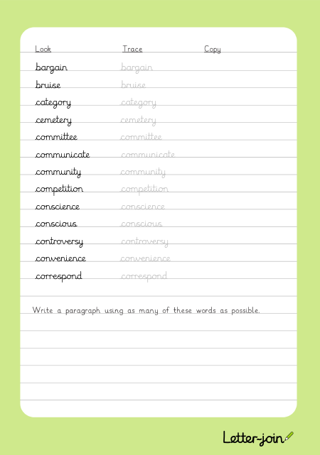

Resource Pack

Slide 9
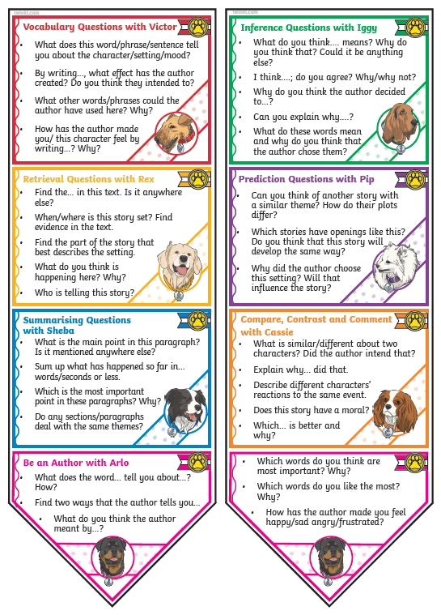
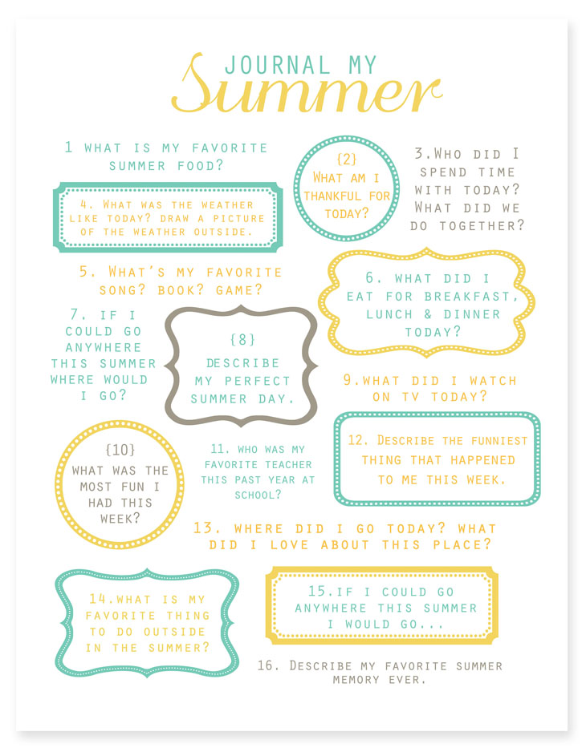
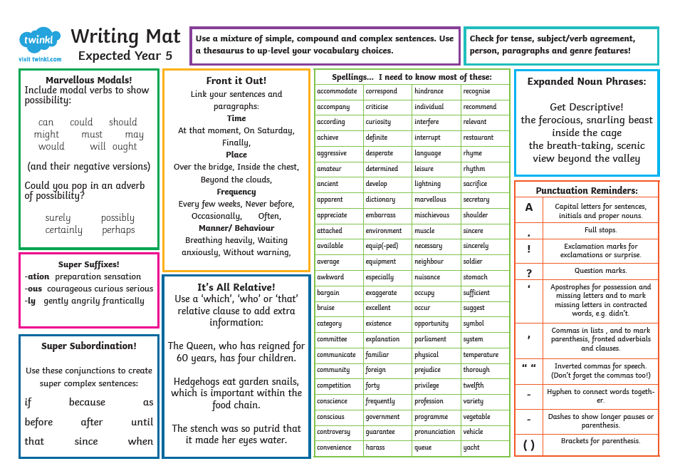
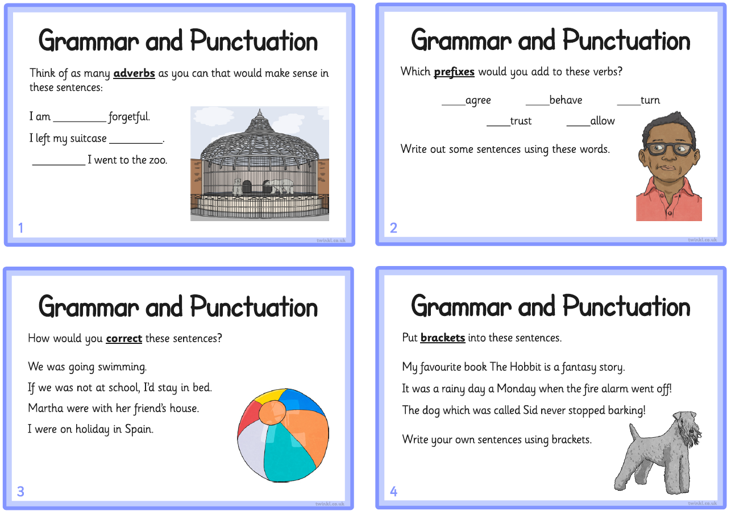
Resource Pack

Slide 10
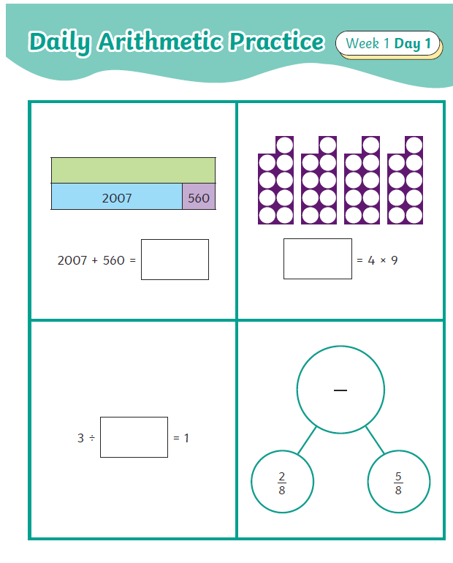

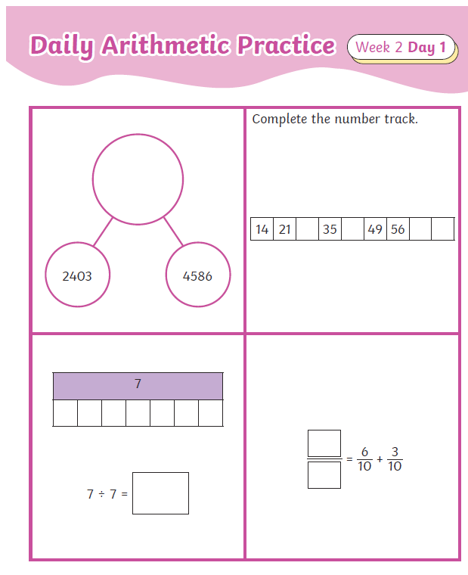
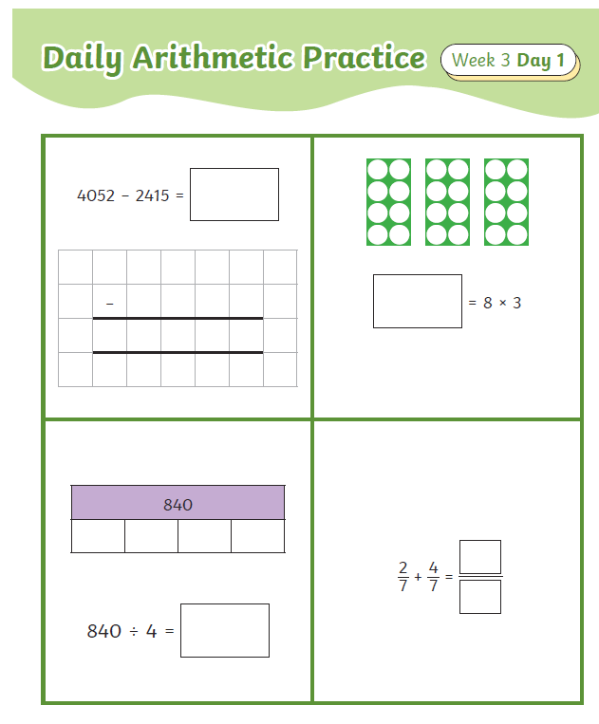
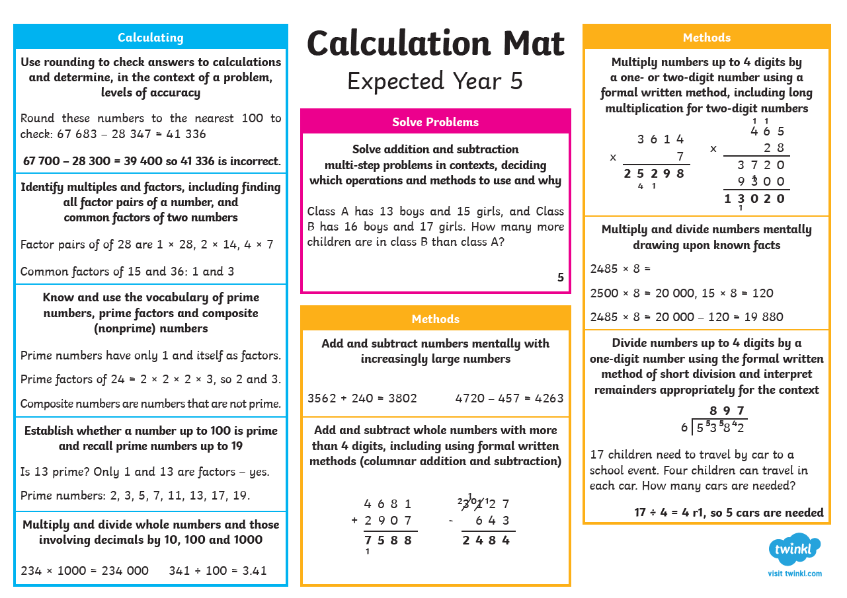
Resource Pack

Slide 11


Tips for Parents
Stay positive & pressure-free
Praise effort
Learn together
Let children choose activities

Slide 12

Questions & Support
Q&A time
Printed packs or online resources available

Slide 13



Final Thought
"Every small effort adds up. A little learning each day helps your child walk into Year 5 with confidence and excitement!"

