Slide 1
Get a Head Start on…
Year 6
Helping Your Child Feel Confident and Ready for the Year Ahead!

Slide 2

Learning powers and values

Slide 3
Why Prepare Over Summer?
Prevent the 'summer slide'
Build confidence before Year 6
Form positive habits in a relaxed environment
Summer learning doesn't have to be formal or intense.
A few simple, fun activities can make a real difference.

Slide 4
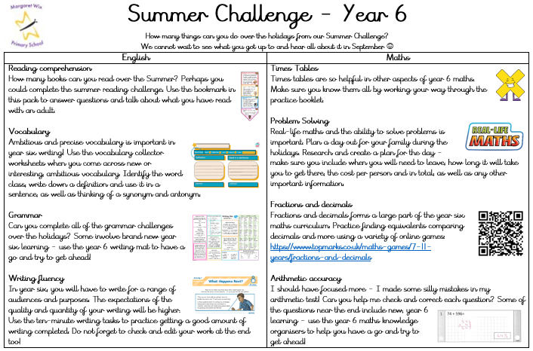
Focus Areas – Year 6 Core Subjects
English:
Reading comprehension
Vocabulary
Grammar
Writing fluency
Maths:
Times tables
Problem solving
Fractions and decimals
Arithmetic accuracy

Slide 5

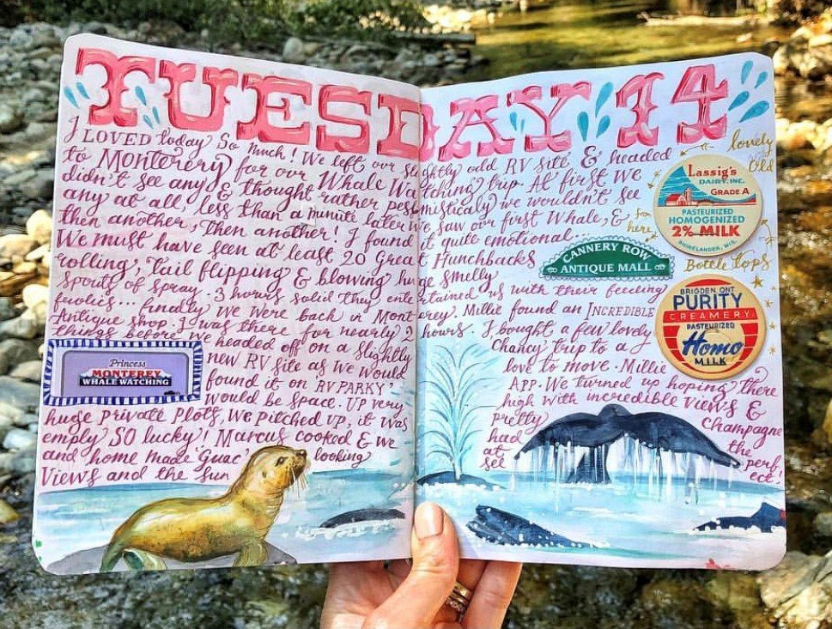
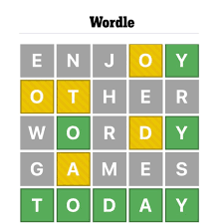
English – Practical Ideas for Home
📚 Reading Together:
Daily reading (20 min)
Mix fiction & non-fiction
Ask questions about the text
📝 Writing Practice:
Summer journal
Postcards or letters
Create stories or comics
🎲 Grammar Fun:
Word games
'Word of the day'
Spot punctuation

Slide 6

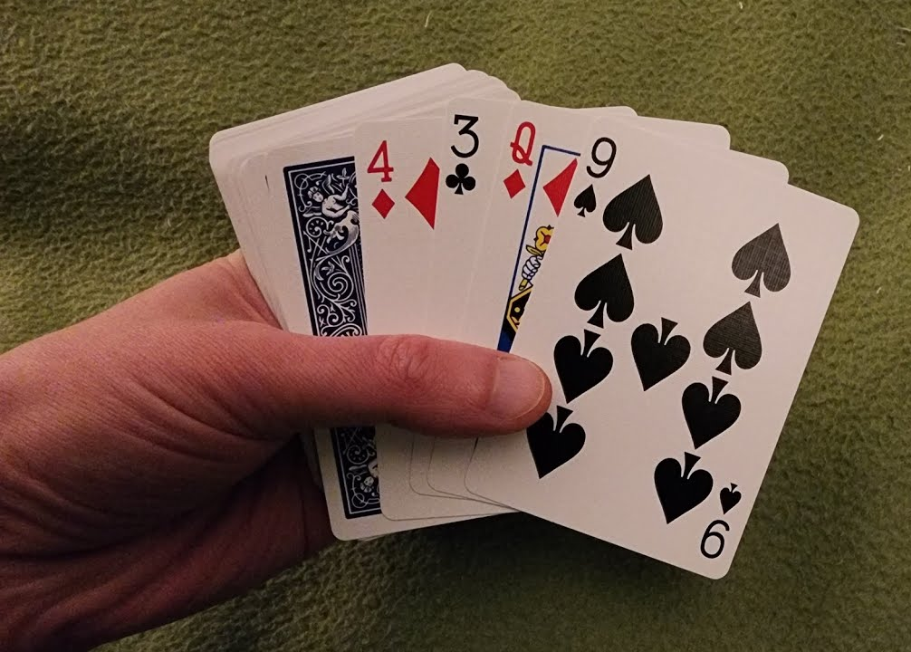
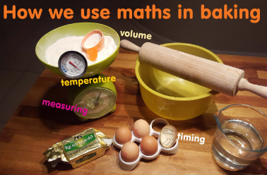
Maths – Practical Ideas for Home
🔢 Times Tables:
Use apps (e.g. TTRockstars)
Practise casually
 Problem Solving:
Use real-life maths
Puzzle books & games
💡 Focus Topics:
Fractions, decimals
Shopping with percentages
5–10 quick questions daily

Slide 7
Screen Time Can Be Learning Time
Educational YouTube (e.g. BBC Bitesize)
Audiobooks for car journeys or quiet time
Spelling, punctuation and grammar practice:
  www.bbc.co.uk/bitesize/articles/zbh892p
  www.topmarks.co.uk/english-games/7-11-years/spelling-and-grammar
Reading practice:
  www.bbc.co.uk/bitesize/articles/z7vm7nb
  www.uk.ixl.com/english/year-6?_gl=1*1r1skve*_up*MQ..&gclid=CPPa8teS_8kCFQbnwgodgOIB6A#reading-strategies
Maths practice:
  www.mathsbot.com/primary/ks2Mini
  www.bbc.co.uk/bitesize/articles/zrd6mfr
  www.bbc.co.uk/bitesize/articles/z7ch6v4
  www.mathsframe.co.uk/en/resources/category/350/Year-6-programme-of-study
  www.ttrockstars.com

Slide 8
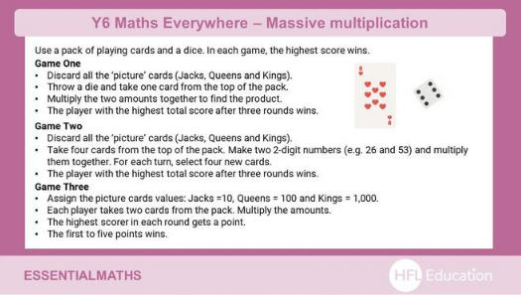

Free & Low-Cost Resources
Local library reading challenges
School website links

Slide 9
Tips for Parents
Stay positive & pressure-free
Praise effort
Learn together
Let children choose activities

Slide 10

Questions
Q&A time
Printed packs or online resources available

Slide 11


Final Thought
Every small effort adds up. A little learning each day helps your child walk into Year 6 with confidence and excitement!

