Slide 1
Get a Head Start on…
Year 2
Helping Your Child Feel Confident and Ready for the Year Ahead!

Slide 2

Learning powers and values

Slide 3
Why Prepare Over Summer?
Prevent the 'summer slide'
Build confidence before Year 2
Form positive habits in a relaxed environment
Summer learning doesn't have to be formal or intense.
A few simple, fun activities can make a real difference.

Slide 4
Focus Areas – Year 2 Core Subjects
English:
- Reading comprehension – retrieval/ predicting/ inferring
- Spelling – common exception words
- Grammar – question marks/ exclamation marks, extending sentences with and/ but/ because/ when, prefixes/ suffixes
- handwriting (beginning to join)
Maths:
number and place value (comparing and ordering numbers to 100/ recognising the value of a digit in a 2 digit number)
telling the time (5 minute intervals)
addition and subtraction problems (to 100)
2x, 3x, 5x and 10x table (multiplication and division facts)
odd and even numbers
identifying and describing 2D and 3D shapes
interpreting pictograms and tally charts

Slide 5



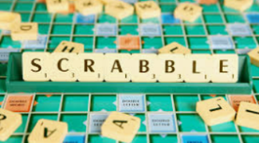
English – Practical Ideas for Home
📚 Reading Together:
Daily reading (20 min)
Mix fiction & non-fiction
Ask questions about the text: What do you think might happen next? How does ___ feel?
📝 Writing Practice:
Summer journal
Postcards or letter (write a reply to letter in the pack)
Handwriting practice (practise common exception words)
🎲 Grammar Fun:
Add suffix/ prefix
'Word of the day'
Word games

Slide 6
Maths – Practical Ideas for Home
🔢 Times Tables:
Practise counting in 2s/ 3s/ 5s and 10s (use https://www.topmarks.co.uk/maths-games/hit-the-button)
Problem Solving:
Use real-life maths (money/ house numbers/cooking/ sharing)
Puzzle books & games
Telling the time (duration)
💡 Focus Topics:
- 2 digit numbers – writing in both words and digits – what is the value of 4 in 48? / odd and even/ addition and subtraction
- 5–10 quick questions daily

Slide 7
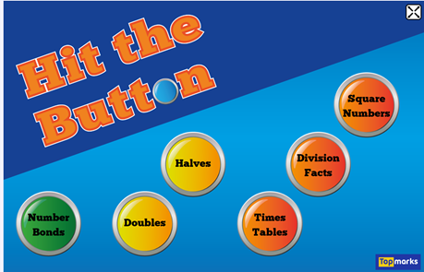

Screen Time Can Be Learning Time
- Educational YouTube (e.g. BBC Bitesize)
https://www.bbc.co.uk/bitesize/primary
https://www.topmarks.co.uk/maths-games/hit-the-button
Audiobooks for car journeys or quiet time

Slide 8

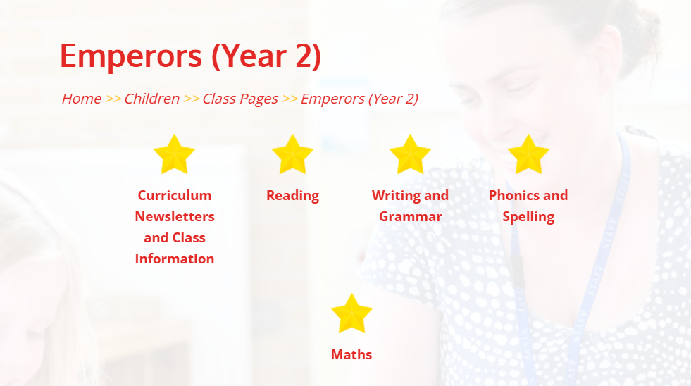
Free & Low-Cost Resources
- Local library reading challenges
- School website links

Slide 9


Tips for Parents
- Stay positive & pressure-free
- Praise effort
- Learn together
- Let children choose activities

Slide 10
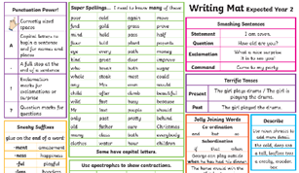
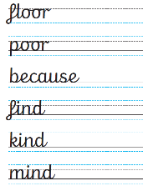

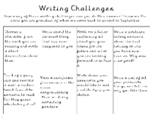
Resource Pack

Slide 11
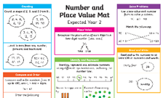
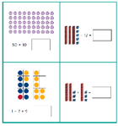
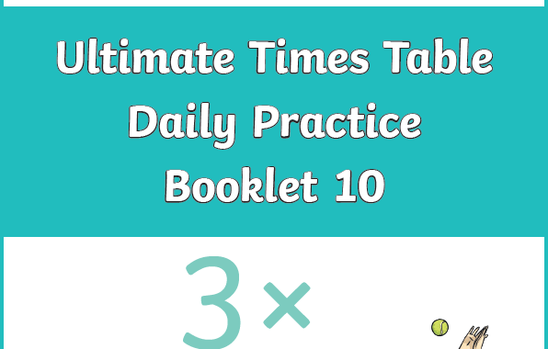
Resource Pack

Slide 12

Questions
- Q&A time
- Printed packs or online resources available

Slide 13


Final Thought
"Every small effort adds up. A little learning each day helps your child walk into Year 2 with confidence and excitement!"

